Slide 1
Instructions
IMPLEMENTING AMPLITUDE ANALYTICS TECHNICAL TRACK: SDK IMPLEMENTATION EXERCISE
As you work through the Battleboat exercise instructions, take a screenshot at each of the following milestones and insert them in the following slides provided.
Install Amplitude with Autocapture
Initialize game event
Select Ship event with event property
Rotate Ship event with event property
Place Ship event with event property
Start Game event with event property
Shoot Ship event with event property
Sink opponent ship event with event property
Example of any one of these user properties: Total Games Played, Total Games Won, or Total Games Lost
Game End event with event property
With Game End event , open the Amplitude instance and show the event with the user properties.

Slide 2
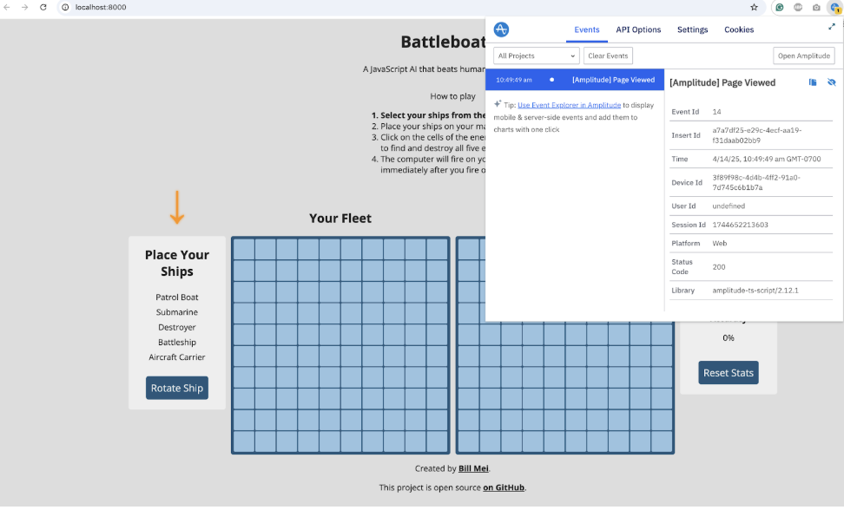
Screenshot 1: Install Amplitude with Autocapture
IMPLEMENTING AMPLITUDE ANALYTICS TECHNICAL TRACK: SDK IMPLEMENTATION EXERCISE
EXAMPLE

Slide 3
Screenshot 2: Initialize game event
IMPLEMENTING AMPLITUDE ANALYTICS TECHNICAL TRACK: SDK IMPLEMENTATION EXERCISE

Slide 4
Screenshot 3: Select Ship event with event property
IMPLEMENTING AMPLITUDE ANALYTICS TECHNICAL TRACK: SDK IMPLEMENTATION EXERCISE

Slide 5
Screenshot 4: Rotate ship event with event property
IMPLEMENTING AMPLITUDE ANALYTICS TECHNICAL TRACK: SDK IMPLEMENTATION EXERCISE

Slide 6
Screenshot 5: Place ship event with event property
IMPLEMENTING AMPLITUDE ANALYTICS TECHNICAL TRACK: SDK IMPLEMENTATION EXERCISE

Slide 7
Screenshot 6: Start game event with event property
IMPLEMENTING AMPLITUDE ANALYTICS TECHNICAL TRACK: SDK IMPLEMENTATION EXERCISE

Slide 8
Screenshot 7: Shoot ship event with event property
IMPLEMENTING AMPLITUDE ANALYTICS TECHNICAL TRACK: SDK IMPLEMENTATION EXERCISE

Slide 9
Screenshot 8: Sink opponent ship event…
IMPLEMENTING AMPLITUDE ANALYTICS TECHNICAL TRACK: SDK IMPLEMENTATION EXERCISE

Slide 10
Screenshot 9: Game end event with event property
IMPLEMENTING AMPLITUDE ANALYTICS TECHNICAL TRACK: SDK IMPLEMENTATION EXERCISE

Slide 11
Screenshot 10: Total Games Played, Total Games Won, or Total Games Lost
IMPLEMENTING AMPLITUDE ANALYTICS TECHNICAL TRACK: SDK IMPLEMENTATION EXERCISE

